Slide 1
biodiversity data from the National Parks Service

Slide 2
the National Parks Service Biodiversity
Data
Significant Calculations
Recommendations for Conservationists

Slide 3
Data
This project has two data sets that came with the package:
One CSV file has information about each species
Another has observations of animals with park locations.
Project Goals
Are certain types of species more likely to be endangered?
How is the observation analysis look compared to endangerment?
How are the species spread amongst the parks?

Slide 4
Species Table snapshot
Above is the data frame with Species entries.
No Intervention was a category added to the data frame to replace the NaN values. They were determined to be NMAR (Not Missing At Random).
Conservation status Count
Endangered 16
In Recovery 4
No Intervention 5633
Species of Concern 161
Threatened 10
The table to the left shows 5633 counts of No Intervention.
This category makes up an overwhelming majority of the data.

Slide 5
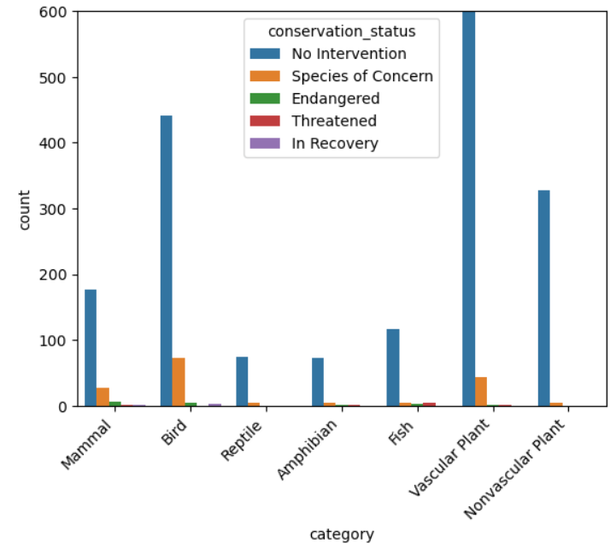
Species Table snapshot
After looking at the graph to the right, there is a disproportionate count of data sets under the vascular plant category and are not in conservation status.

Slide 6
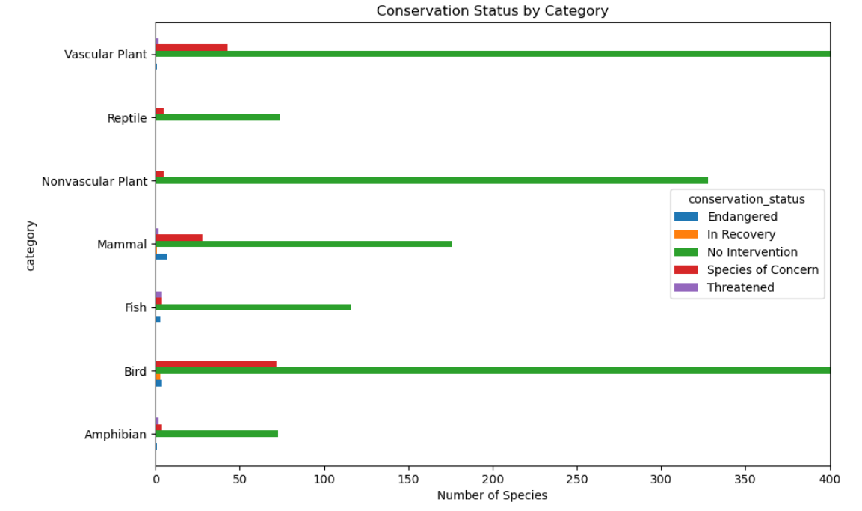
Significant Calculations
Conservation Status
Reviewing the graph on the right and the cross table in the next slide, Mammals and birds are the least in No Intervention status at 82.2% and 84.8%, respectively.
Mammals have the most Endangered status at 3.2%, followed by Fish at 2.4%.

Slide 7
Significant Calculations
Conservation Status Cross Table
Fish, along with Amphibians, are the most Threatened by far at 3.1% and 2.5%, respectively.
Plants are doing just fine, especially Vascular plants.
They are both 98-99% No Intervention status.
The In Recovery status is the smallest portion of the dataset with only Birds and Mammals listed at 0.6% and 0.5%, respectively.

Slide 8
Significant Calculations
Word Count
0 Myotis 15
1 Bat 12
2 Brown 7
3 Northern 6
4 American 6
Bats
After running a word count through the common-names column, we see a table like the one on the right. This helps organize the data into common animal names and their appearances in the dataset.
Myotis is a type of bat, which means Bats are easily the most protected species showing up 15-27 times in the data set. The next applicable word for an animal is Wolf at a 4 count, which is 3 to 4 times less than Bats.

Slide 9
Observations Table snapshot
The two data frames are joined and filtered to only Bat observations and we get 208 entries. Above is a preview of the table.

Slide 10
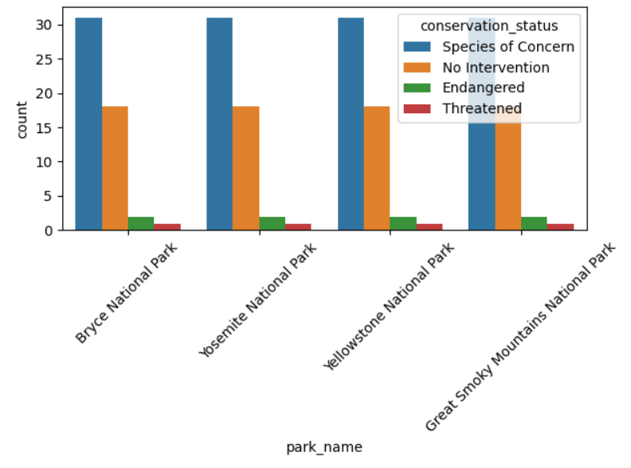
Observations Table Bats
If we graph the observations across the parks, we see a uniform graph like the one on the right.
'Species of Concern' and 'No Intervention' make up most observations. 'Endangered' and 'Threatened' are present in very small numbers.
More bats are protected as a 'Species of Concern' than 'No intervention', meaning there are less unprotected Bats than not.
Although, the ‘Endangered' and 'Threatened' make up a small portion of the data.

Slide 11
Recommendations for Conservationists

Slide 12
recommendation for conservationists
This project was also able to answer some of the questions first posed in the beginning:
Are certain types of species more likely to be endangered?
How is the observation analysis look compared to endangerment?
How are the species spread amongst the parks?
Mammals and Birds had the highest percentage of being protected. Bats were most common.
Observations across the park were uniform suggesting the location does not affect the data.
Few observations of 'Threatened" and "Endangered" bats, but more Bats are in protected status than not. This suggests while most Bats are protected, the few in most danger can recieve more focus and attention.

Slide 13
recommendation for conservationists
Other take aways include that across all four parks, bat show a consistent pattern in sightings with no major differences. 'Species of Concern' and 'No Intervention' make up most observations. 'Endangered' and 'Threatened' are present in very small numbers, equally.
This implies conservation pressures on Bats are systemic rather than specific to one park. More bats are protected as a 'Species of Concern' than 'No intervention', meaning there are less unprotected Bats than not, but the "endangered' and 'Threatened' make up a small portion. This could mean Bats are well protected and those with the most danger can be focused on.

Slide 14
recommendation for conservationists
Fish, along with Amphibians they are the most Threatened by far at 3.1% and 2.5%, respectively. This warrants further investigation into these water-biome animals and their habitats.
The In Recovery status is the smallest portion of the dataset with only Birds and Mammals listed at 0.6% and 0.5%, respectively. This needs further investigation into the lack of In Recovery species.

Slide 15
THANK YOU
Jacob Ledger

